Slide 1


DNS & CDN
SE3331-1 (2022 Fall)
IPADS, Shanghai Jiao Tong University
https://www.sjtu.edu.cn
xx

Slide 2
The Design of DNS
Domain Name Service

Slide 3
DNS: Binding IP and Domain Name
Names: hostname strings
E.g., www.sjtu.edu.cn
Values: IP addresses
E.g., 202.120.2.119
Look-up algorithm
Resolves a hostname to an IP address so that your machine knows where to send packets
DNS主要作用：
将域名和IP addr进行映射

Slide 4
IP Address as a Type of Name
An IP address itself is a type of name
A structured name that is used to locate an object
Use IP address to identify the server
Recall your labs in ICS on socket
On Internet
The router will know where to send a packet with destination IP
Hostname has no such semantic
A router does not know how to send a packet to "baidu.com"

Slide 5
Why Not Just Using IP Address?
IPs are structured in a particular way for routing
You cannot chose your IP address as you wish
Note: usually an address cannot be picked
While you can chose your host names
IPs are not user-friendly enough
域名并不能向IP一样提供设备定位的语义，那为何不能单独使用IP，而要额外使用host-name？
1.IP会随着设备位置改变而改变，并且IP一般不是设备自己选定的，而是被分配的。
2.IP只是一串数字，对于用户不够友好(这个与在inode-based system中我们要使用file-name layer而不能到inode-num layer就结束的原因类似。通过添加indirect的方式来解决一些对于上层不友好的问题)。

Slide 6
Questions on DNS
Q: Can a name have multiple values (IP addresses)?
Yes.(一个域名对应于多个IP，用于进行负载均衡)
This allows a web server to balance its load over multiple machines
Also allows a client to choice a nearest IP to access
Q: Can a single value have multiple names?
Yes.
This allows server consolidation(合并)
一个IP地址对应于多个域名的几种可能的实现方式：
1.通过具体的domain name来对应到不同的dir。
2.通过不同的port来访问。

Slide 7
Questions on DNS
Q: Can the value corresponding to a name change?
Yes.
This allows to change the physical machine (with different IP) that stores the data without changing the hostname
Such changing is hidden to clients

Slide 8
Look-up Algorithm
At first, each machine kept a "hosts.txt" for address binding
E.g., "r900 202.120.224.83"
Using table look-up to resolve the binding
This method cannot scale in Internet(需要手动的添加新的map信息)
1984, four Berkeley students wrote BIND
Berkeley Internet Name Domain
Still the dominant DNS software in use

Slide 9
Distributing Responsibility
The binding
Too large to be stored on a single machine
Thus, the data are stored on many machines
As known as "name servers"
How to know which name server has a particular binding?
Solution: structure the hostname
Names have a hierarchy, e.g., com, net, gov, correspond to "zones"
Zones are mapped to name servers

Slide 10

Name Servers
The root zone
Maintained by ICANN, non-profit
The ".com" zone
Maintained by VeriSign, add for money
The ".sjtu.edu.cn" zone
Maintained by SJTU

Slide 11
DNS Hierarchy (a partial view)

Slide 12
Basic DNS Look-up Algorithm
Example: lookup IP of "ipads.se.sjtu.edu.cn"
Traverse the name hierarchy from the root
The root will tell us the "cn" name server IP,
which will tell us the "edu.cn" name server IP,
which will tell us the "sjtu.edu.cn" name server IP,
which will tell us the "se.sjtu.edu.cn" name server IP,
which finally tells us the "ipads.se.sjtu.edu.cn" IP
Such algorithm is called delegation(委派)

Slide 13
DNS Lookup

Slide 14
DNS Lookup

Slide 15
DNS Lookup

Slide 16
DNS Lookup

Slide 17
DNS Lookup

Slide 18
Context in DNS
Names in DNS are global (context-free)
A hostname means the same thing everywhere in DNS
Actually, it should be "ipads.se.sjtu.edu.cn."
A hostname is a list of domain names concatenated with dots
The root domain is unnamed, i.e., "." + blank
真正的root domain name=“”，这与文件系统中的root=“”类似

Slide 19
Fault Tolerant
Each zone can have multiple name servers
A delegation usually contains a list of name servers
If one name server is down, others can be used
由于一个zones有多个name server构成分布式存储，就可能会存在不一致的问题，但是这个问题在DNS中不会很明显，因为一个域名被访问的概率应该是要远远大于被修改的概率的。因而DNS的fault-tolerance相对好处理

Slide 20
Three Enhancements on Look-up Algorithm
1. The initial DNS request can go to any name server, not just the root server
Even on your own machine: /etc/hosts
You can specific name servers in /etc/resolv.conf
If no record, just return address of the root server
Q: what are the benefits?
Notes:
To minimize the load of the root server.

Slide 21
Three Enhancements on Look-up Algorithm
2. Recursion
A client asks a name server "www.baidu.com"
The name server does all the lookup through the tree and return the IP of Baidu to the client
Usually, a name server has a better network connection

Slide 22
DNS Request Process
non-recursion:需要多次请求，但是是stateless的，因为
每次发送的请求是一样的
recursion:只需要一次请求，但是是stateful的，因为每次递归都需要额外存储当前已经处理到的name位置。
a.root.net
a.root.net
names.edu
names.edu
NS: for edu
ns.iss.edu
ns.iss.edu
NS: for
Scholarly.edu
ginger.
Scholar.edu
ginger.
Scholar.edu
ginger.
Scholar.edu
AP: for
ginger.Scholar.edu
Name client
Name client
Non-Recursion
Recursion

Slide 23
Three Enhancements on Look-up Algorithm
3. Caching
DNS clients and name servers keep a cache of names
Your browser will not do two look-ups for one address
Cache has expire time limit
Controlled by a time-to-live parameter in the response itself
E.g., SJTU sets the TTL of www.sjtu.edu.cn to 24h
TTL (Time To Live)
Long TTL VS. short TTL
Q: what are the tradeoffs?
long TTL:cache若存活时间过长，则出现cache与实际内容不一致的可能性更大了。
short TTL:cache存活时间过短，则cache作用不会很明显，即还是会需要大量的顶层的DNS的request。

Slide 24
Combine These Enhancements
If:
Many machines at SJTU use the SJTU name server for their initial DNS query
The name server offers recursive querying and caching
Then:
The name server's cache will hold many bindings
Performance benefits from this large cache

Slide 25
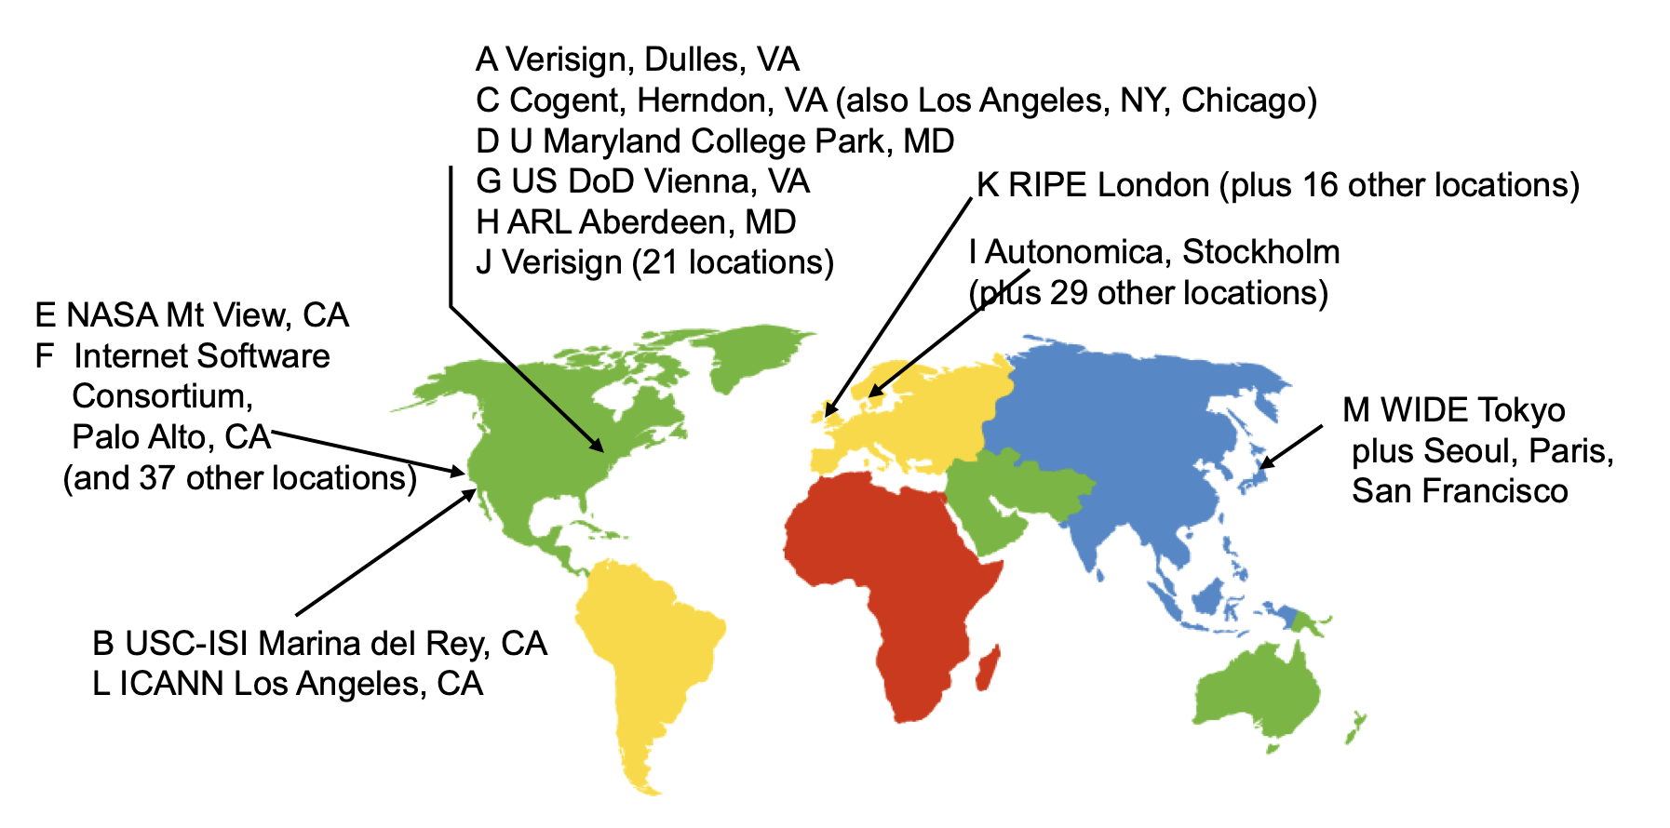
Other Features of DNS
At least two identical replica servers
80 replicas of the root name server in 2008
Replicas are placed separated around the world

Slide 26
Other Features of DNS
Organization's name server (e.g., SJTU)
Several replicas in campus
To enable communications within the organization
At least one out of the campus
To validate the address for outside world

Slide 27
Name Discovery in DNS (at the first place)
A client must discover the name of a nearby name server
Name discovery broadcast to ISP at first time
Ask network manager
Ask by email, Google, etc.

Slide 28
Comparing Host-name & File-name
They are both for more user friendly
File-name -> inode number
Host-name -> IP address
Both names are hierarchical; inode num and IP address are plane
They are both not a part of the object
File-name is not a part of a file (stored in directory)
Host-name is not a part of a website (stored on name server)
Name and value binding
File: 1-name -> N-values (no); N-name -> 1-value (yes)(LINK)
DNS: 1-name -> N-values (yes); N-name -> 1-value (yes)

Slide 29
Behind the DNS Design
Why was DNS designed in this way?

Slide 30
Benefits of Hierarchical Design
Hierarchies delegate responsibility
Each zone is only responsible for a small portion
Hierarchies also limit interaction between modules
A type of de-centralization
但是DNS会牺牲CAP中的一致性，因为DNS在某个record修改之后也不会去修改自己本地的cache。

Slide 31
Good Points on DNS Design
Global names (assuming same root servers)
No need to specific a context(上下文)
DNS has no trouble generating unique names
The name can also be user-friendly
Scalable in performance
Simplicity: look-up is simple and can be done by a PC
Caching: reduce number of total queries
Delegation: many name severs handle lookups

Slide 32
Good Points on DNS Design
Scalable in management
Each zone makes its own policy decision on binding
Hierarchy is great here
Fault tolerant
If one name server breaks, other will still work
Duplicated name server for a same zone

Slide 33
Bad Points on DNS Design
Policy(容易受到DNS管理者的控制)
Who should control the root zone, .com zone, etc.? The governments?
Significant load on root servers
Many DNS clients starts by talking to root server
Many queries for non-existent names,(因为这个域名是不存在的，所以在查找的时候最终一定会到达root) becomes a DoS attack(deny of service,拒绝服务攻击，一般指的是服务器接受了大量的恶意请求被占满了网络空间，从而拒绝掉正常请求的攻击方式)
Security
How does a client know if the response is correct?(钓鱼)
How does VeriSign know "change Amazon.com IP" is legal?

Slide 34
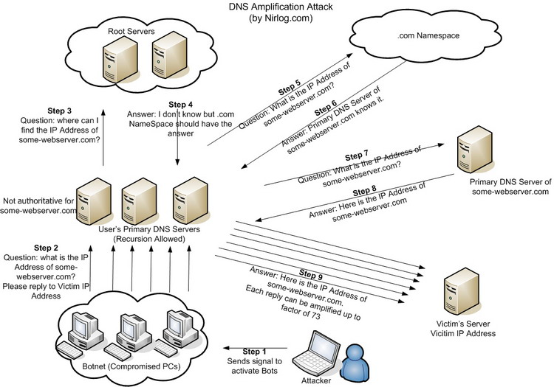
DNS Amplification Attack
Bot：肉机
这个攻击说的是攻击者通过伪造DNS请求的发出者IP来使得要攻击的服务器在短时间内受到大量并不是自己发出的DNS请求从而崩溃
从这里还可以知道,攻击目标并没有与DNS建立直接连接也会受到请求，说明DNS通信是可以基于无连接进行的，如UDP协议。

Slide 35
DNS Security
DNS Hijack: Cutting the binding between name and IP
DNS DoS (Denial of Service) attack
BAOFENG.com & DNSPod
2009-5-18: DNSPod was attacked and banned
2009-5-19: The Internet in China was almost down
Fixed timer: query for BAOFENG.com once per second!
Solutions
/etc/hosts, dnsmasq, OpenDNS, etc.
DNS shield to defend against DoS attack

Slide 36

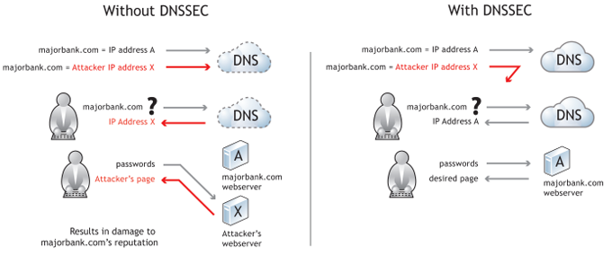
DNSSEC: Protect DNS Record
Only part of the zones are using DNSSEC, e.g., .gov, .org

Slide 37
Naming Scheme
Naming: the glue of modules

Slide 38
Naming in General
ipads.se.sjtu.edu.cn – hostname
steven@apple.com - email
steven – username
EAX - x86 processor register name
main() - function name
WebBrowser - class name
/courses/cse/index.html - path name (fully-qualified)
index.html - path name (relative)
http://ipads.se.sjtu.edu.cn/courses/cse/index.html - URL
13918275839- Phone number
202.120.40.188 - IP Address

Slide 39
Naming a Disk(disk作为一个设备也可以有名字和编号)
File name: /dev/sda1
As a special type of inode: device inode
8,0 as (major, minor)
PCI(外设组件互连标准) address (name): 19:00.0
SCSI storage controller: LSI Logic / Symbios Logic SAS1068E PCI-Express Fusion-MPT SAS (rev 08)

Slide 40
Naming for Modularity
Retrieval: e.g., using URL to get a web page
Sharing: e.g., passing an object reference to a function
Save space as well: only sending the name, not the object
Hiding: e.g., using a file name without knowing file system
Can support access control: use an object only if knowing its name
E.g., Windows has many undocumented API
User-friendly identifiers: e.g., “homework.txt” instead of 0x051DE540
Indirection: e.g., OS can move the location of the file data without notifying the user
Have you ever defragmented your hard driver?

Slide 41
Addresses as Names
Software uses these names in an obvious way
E.g., memory addresses
Hardware modules connected to a bus
Use bus addresses (a kind of name) for interconnection

Slide 42
Naming Schemes
A naming schemes contains three parts:
1. Set of all possible names (名字的值域)
You cannot use ‘for’ as a variable in C
2. Set of all possible values
3. Look-up algorithm to translate a name into a value
or a set of values, or “none”

Slide 43
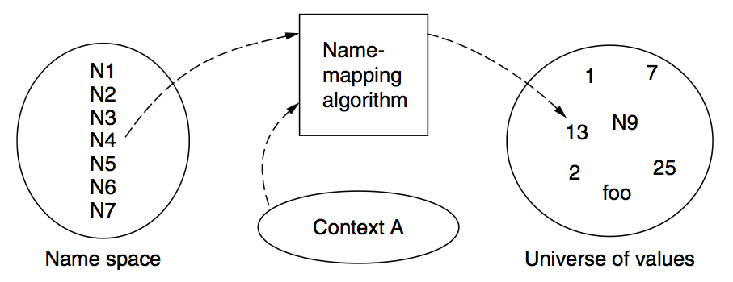
Naming Model

Slide 44
Naming Terminology
Binding – A mapping from a name to value
Unbind is to delete the mapping
A name that has a mapping is bound
A name mapping algorithm resolves a name

Slide 45
Naming Context
Type-1: context and name are separated
E.g., inode number’s context is the file system
Type-2: context is part of the name
E.g., xiayubin@sjtu.edu.cn
Name spaces with only one possible context are called universal name spaces
Example: credit card number, UUID, email address

Slide 46
Determining Context - 1
Hard code it in the resolver
Examples: Many universal name spaces work this way
Embedded in name itself
cse@sjtu.edu.cn:
Name = “cse”
Context = “sjtu.edu.cn”
/ipads.se.sjtu.edu.cn/courses/cse/README :
Name = “README”
Context = “/ipads.se.sjtu.edu.cn/courses/cse”

Slide 47
Determining Context - 2
Taken from environment (Dynamic)
Unix cmd: “rm foo”:
Name = “foo”, context is current dir
Question: how to find the binary of “rm” command?(path)
Read memory 0x7c911109:
Name = “0x7c911109”,
Context is thread’s address space
Many errors in systems due to using wrong context

Slide 48
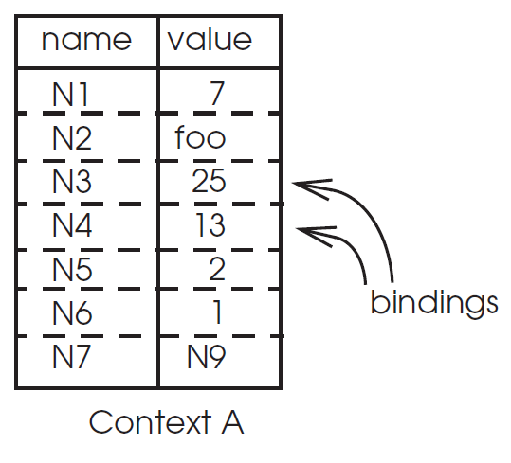
Name Mapping Algorithms - 1
Table lookup
Find name in a table
E.g., Phone book
Context: which table?
Implicit VS. explicit
Default context

Slide 49
Name Mapping Algorithms - 2
Recursive lookup
E.g., “/usr/bin/rm”
First find “usr” in “/”, then find “bin” in “/usr”, then “rm”
Each look-up process is the same
Multiple lookup
Recall: how to find “rm” without absolute name?
$PATH
E.g., “/usr/local/sbin:/usr/local/bin:/usr/sbin:/usr/bin:/sbin:/bin”
Look-up in a predefined list of context

Slide 50
Interpreter Naming API
value ← RESOLVE(name, context)
Return the mapping of name in the context
status ← BIND(name, value, context)
Establish a name to value mapping in the context
status ← UNBIND(name, context)
Delete name from context
list ← ENUMERATE(context)
Return a list of all bindings
result ← COMPARE(name1, name2)
Check if name1 and name2 are equal

Slide 51
FAQ of Naming Scheme - 1
What is the syntax of names?
What are the possible value?
What context is used to resolve names?
Who specifies the context?
Is a particular name global (context-free) or local?

Slide 52
FAQ of Naming Scheme - 2
Does every name have a value?
Or, can you have “dangling” names?
Can a single name have multiple values?
Does every value have a name?(不一定,举的例子是每一个物理地址不一定都有一个虚拟地址与其对应)
Or, can you name everything?
Can a single value have multiple names?
Or, are there synonyms?
Can the value corresponding to a name change over time?

Slide 53
Content Distribution
Files on the Internet

Slide 54
Review: scalable websites
Scalable websites are powered by distributed systems
How to support geographical users?
Caching server
Caching server
Caching server
…
Caching
Caching
Caching
Distributed caching
Database server
Database server
CDN
Users
Application #1
generate the page
Database
user, price
…
Database
user, price
Application server
Distributed database
Internet
Load
Balance
Application #2
add the order
File server
File server
File server
File:
image
File:
image
…
File:
image
Application server
…
…
Message queue
Distributed file system

Slide 55
Content Distribution
How to reduce load latency over Internet?
Especially for large files, e.g., images and videos
Client side
Many people from SJTU might access same web pages
Save bandwidth by caching a local copy
Server side
Not all clients use cache
Push data out to content distribution network (CDN)
server希望主动的在一个节点上面进行cache，而不是user
来访问的时候被动的做一次cache。

Slide 56
Caching Examples
Web browser caches recently accessed files
E.g., allow "back" button to operate more efficiently
Web proxies cache recently accessed URLs
Save bandwidth/time when multiple people locally access same remote URL
DNS resolvers cache resource records (URL→IP)
NFS clients cache read/written data

Slide 57
Content Distribution Network (CDN)
Network of computers that replicate content across the Internet
Bringing content closer to requests
End users only use local (not shared) network capacity
Content providers actively pushes data into the network
Improve performance and reduce costs

Slide 58
Content Distribution Network (CDN)
Akamai as an example

Slide 59
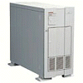

Server Selection Mechanism
Application
HTTP redirection
Advantages
Fine-grain control
Selection based on client IP address
Disadvantages
Extra round-trips for TCP connection to server
Overhead on the server
2.Redirect指的是server1通知client离client更
近的那个server的位置。
1.GET
2.Redirect
3.GET
4.OK

Slide 60
Server Selection Mechanism
Routing
Anycast routing
Advantages
No extra round trips
Route to nearby server
Disadvantages
Does not consider network or server load
Different packets may go to different servers
Used only for simple request-response apps
1.2.3.0/24
1.2.3.0/24

Slide 61
Server Selection Mechanism
Naming
DNS-based server selection(直接通过DNS来找到离得更近的IP)
Advantages
Avoid TCP set-up delay
DNS caching reduces overhead
Relatively fine control
Disadvantage
Based on IP address of local DNS server
“Hidden load” effect
DNS TTL limits adaptation
1.2.3.4
DNS
query
1.2.3.5
local DNS server

Slide 62
How Akamai Uses DNS
cnn.com (content provider)
DNS TLD server
Akamai
cluster
Akamai global
DNS server
1
2
GET index.html
http://cache.cnn.com/foo.jpg
Akamai regional
DNS server
Nearby Akamai
cluster
End user

Slide 63
How Akamai Uses DNS
cnn.com (content provider)
DNS TLD server
DNS lookup
cache.cnn.com
Akamai
cluster
Akamai global
DNS server
1
2
3
4
ALIAS:
g.akamai.net
Akamai regional
DNS server
Nearby Akamai
cluster
End user

Slide 64
How Akamai Uses DNS
cnn.com (content provider)
DNS TLD server
DNS lookup
g.akamai.net
Akamai
cluster
Akamai global
DNS server
5
1
2
3
4
6
Akamai regional
DNS server
ALIAS
a73.g.akamai.net
Nearby Akamai
cluster
End user

Slide 65
How Akamai Uses DNS
cnn.com (content provider)
DNS TLD server
Akamai
cluster
Akamai global
DNS server
5
1
2
3
4
6
Akamai regional
DNS server
7
DNS a73.g.akamai.net
8
Address
1.2.3.4
Nearby Akamai
cluster
End user

Slide 66
How Akamai Uses DNS
cnn.com (content provider)
DNS TLD server
Akamai
cluster
Akamai global
DNS server
5
1
2
3
4
6
Akamai regional
DNS server
7
8
9
Nearby Akamai
cluster
End user
GET /foo.jpg
Host: cache.cnn.com

Slide 67

How Akamai Uses DNS
cnn.com (content provider)
DNS TLD server
GET foo.jpg
11
12
Akamai
cluster
Akamai global
DNS server
5
1
2
3
4
6
Akamai regional
DNS server
7
8
9
Nearby Akamai
cluster
End user
GET /foo.jpg
Host: cache.cnn.com

Slide 68
How Akamai Uses DNS
cnn.com (content provider)
DNS TLD server
11
12
Akamai
cluster
Akamai global
DNS server
5
1
2
3
4
6
Akamai regional
DNS server
7
8
9
Nearby Akamai
cluster
End user
10

Slide 69
How Akamai Works: Cache Hit
cnn.com (content provider)
DNS TLD server
Akamai
cluster
Akamai global
DNS server
1
2
Akamai regional
DNS server
3
4
5
Nearby Akamai
cluster
End user
6

